Slide 1

FACTOR ANALYSIS
Faroque Ahmed
Research Associate
Bangladesh Institute of Governance and Management (BIGM)

Slide 2
Factor Analysis (FA)
An exploratory data analysis method
Search influential underlying factors or latent variables
From a set of observed variables
It helps in data interpretations by reducing the number of variables.
Factor analysis is a method for investigating whether a number of variables of interest X1, X2,……., Xl, are linearly related to a smaller number of unobservable factors F1, F2,..……, Fk.

Slide 3
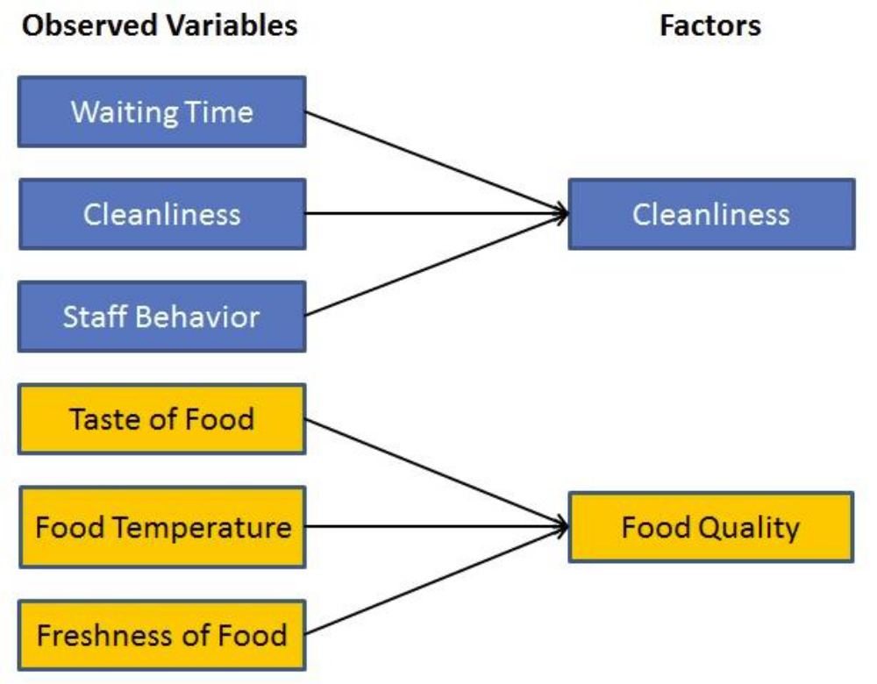

Slide 4
Types of Factor Analysis
Exploratory Factor Analysis: It is the most popular factor analysis approach among social and management researchers. Its basic assumption is that any observed variable is directly associated with any factor.
Confirmatory Factor Analysis (CFA): Its basic assumption is that each factor is associated with a particular set of observed variables. CFA confirms what is expected on the basic.

Slide 5
Bartlett's test of sphericity
Bartlett's test of sphericity is used to test the hypothesis that the variables are uncorrelated in the population (i.e., the population correlation matrix is an identity matrix)
Correlation matrix
A correlation matrix is a lower or upper triangle matrix showing the simple correlations, r, between all possible pairs of variables included in the analysis. The diagonal elements are all 1.

Slide 6
Kaiser-Meyer-Olkin (KMO) Test
It measure of sampling adequacy. Used to examine the appropriateness of factor analysis. High values (between 0.5 and 1.0) indicate appropriateness. Values below 0.5 imply not.
Communality
Amount of variance a variable shares with all the other variables. This is the proportion of variance explained by the common factors.
Eigenvalue
Represents the total variance explained by each factor.

Slide 7
Factor loadings
Correlations between the variables and the factors.
Factor matrix
A factor matrix contains the factor loadings of all the variables on all the factors
Factor scores
Factor scores are composite scores estimated for each respondent on the derived factors.

Slide 8
Percentage of variance
The percentage of the total variance attributed to each factor.
Scree plot
A scree plot is a plot of the Eigenvalues against the number of factors in order of extraction.
Factor Rotation
Rotation is a tool for better interpretation of factor analysis. Rotation can be orthogonal or oblique. It re-distributed the commonalities with a clear pattern of loadings.

Slide 9
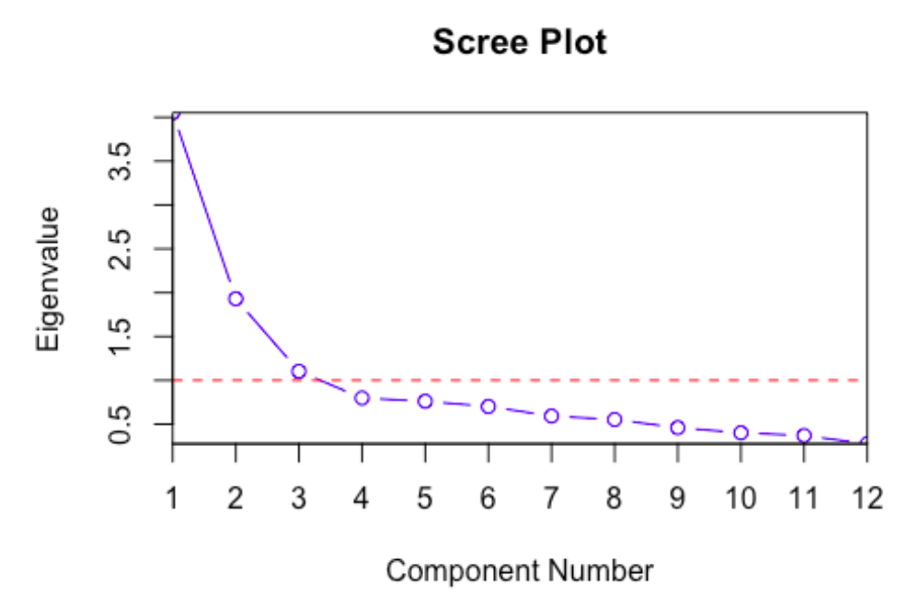

Slide 10
Thank You for your Patience

